Slide 1


SAP UI5 FIORI
JavaScript - Part C
www.zarantech.com
© Copyright 2021, ZaranTech LLC. All rights reserved.

Slide 2

Disclaimer
2
This presentation, including examples, images, and references are provided for informational purposes only.
Complying with all applicable copyrights laws is the responsibility of the user.
Without limiting the rights under copyright, no part of this document may be reproduced, stored or introduced into a retrieval system, or transmitted in any form or by any means.
Credits shall be given to the images taken from the open-source and cannot be used for promotional activities.
© Copyright 2021, ZaranTech LLC. All rights reserved.

Slide 3
Agenda
3
Radio buttons and check boxes
Creating HTML Elements
Modifying HTML Elements
Appending HTML Elements
Deleting HTML Elements
Regular Expressions
Object Oriented JavaScript
Prototype in JavaScript
JavaScript Literals
© Copyright 2021, ZaranTech LLC. All rights reserved.

Slide 4
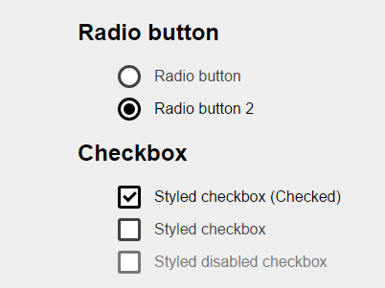
Radio buttons and check boxes
2
For selecting multiple options from a list, Checkboxes can be used.
Radio buttons allows to select only one of a predefined set of mutually exclusive options.
‹#›
© Copyright 2021, ZaranTech LLC. All rights reserved.

Slide 5
Creating HTML Elements
2
HTML elements often contains text.
To create a button with text, use the innerText or innerHTML properties of the element object.
The createElement() method creates an Element Node with the specified name.
Syntax - document.createElement(nodename)
‹#›
© Copyright 2021, ZaranTech LLC. All rights reserved.

Slide 6
Modifying HTML Elements
2
JavaScript can modify all the HTML elements in the page.
To modify the content of an HTML element, use this syntax: document.getElementById(id).innerHTML = new HTML
To modify the value of an HTML attribute, use this syntax:
document.getElementById(id).attribute = new value
‹#›
© Copyright 2021, ZaranTech LLC. All rights reserved.

Slide 7
Appending HTML Elements
2
The appendChild() method appends a node as the last child of a node.
This method is also used to move an element from one element to another.
Syntax used - node.appendChild(node)
‹#›
© Copyright 2021, ZaranTech LLC. All rights reserved.

Slide 8
Deleting HTML Elements
2
Select the HTML element which need to remove.
Use JavaScript remove() and removeChild() method to remove the element from the HTML document.
The remove() method deletes the specified element from the HTML.
Syntax - node.remove()
‹#›
© Copyright 2021, ZaranTech LLC. All rights reserved.

Slide 9
Regular Expressions
2
An object that describes a pattern of characters is referred to as regular expression.
Regular expressions are used to perform pattern-matching and "search-and-replace" functions on text.
Syntax - /pattern/modifiers;
‹#›
© Copyright 2021, ZaranTech LLC. All rights reserved.

Slide 10
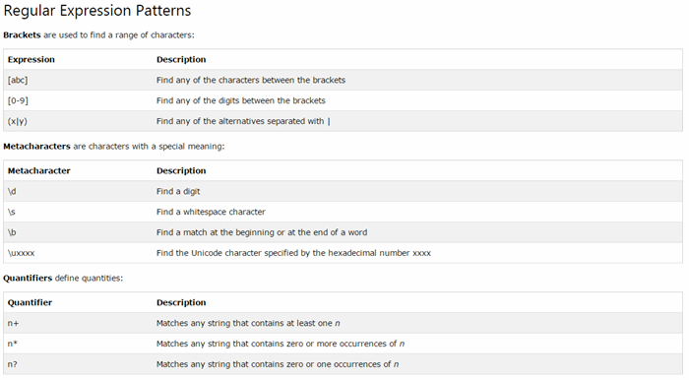
Regular Expressions
2
‹#›
© Copyright 2021, ZaranTech LLC. All rights reserved.

Slide 11
Object Oriented JavaScript
2
JavaScript is a prototype based object oriented language.
It doesn't have classes rather it define behaviors using constructor function and then reuse it using the prototype.
Features:
Object, property, and method.
Class.
Encapsulation and Abstraction.
Reusability/inheritance.
Polymorphism.
Association and Aggregation.
‹#›
© Copyright 2021, ZaranTech LLC. All rights reserved.

Slide 12
Prototype in JavaScript
2
The prototype is an object that is associated with every functions and objects by default in JavaScript, where function's prototype property is accessible and modifiable and object's prototype property is not visible.
All JavaScript objects inherit properties and methods from a prototype.
It allows to easily define methods to all instances of a particular object.
‹#›
© Copyright 2021, ZaranTech LLC. All rights reserved.

Slide 13
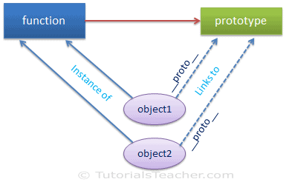
Prototype in JavaScript
2
‹#›
© Copyright 2021, ZaranTech LLC. All rights reserved.

Slide 14
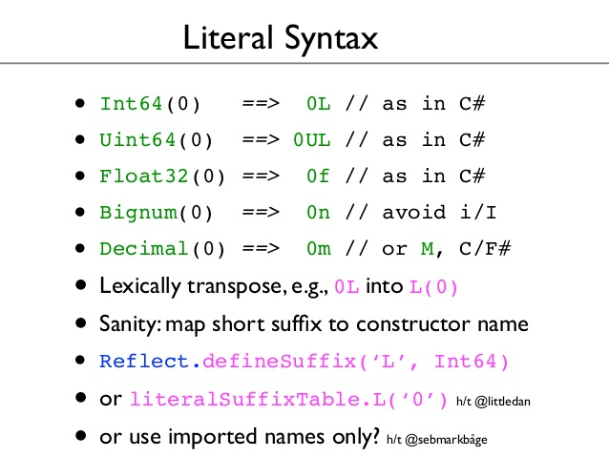
JavaScript Literals
2
JavaScript Literals are constant values that can be assigned to the variables that are called literals or constants.
JavaScript Literals are syntactic representations for different types of data like numeric, string, Boolean, array, etc data.
‹#›
© Copyright 2021, ZaranTech LLC. All rights reserved.

Slide 15
Thank you
Subscribe to our Channel for more Informative Videos.
https://www.youtube.com/user/ZaranTech

